Slide 1
To Do List Project Presentation
By Kiera Walton

Slide 2
Project Summary
The Goal: to create a full stack OOP-based web application
The Application: a simple to do list application, with which users can interact via a web page
The Functionality: the application has basic CRUD functionality - users can create, read and update to do lists upon accessing the web page, and the details they enter will be stored in a locally hosted database

Slide 3
Technologies
GitHub - Version Control and Continuous Integration
Jira - Project Management
Spring - IDE
Maven - Build Tool
Java, HTML, CSS, Javascript - Front End Source Code
JUnit, Mockito, Selenium - Testing
MySQL - Relational Database Language
SonarQube - Static Analysis
Postman - assisted the API development

Slide 4
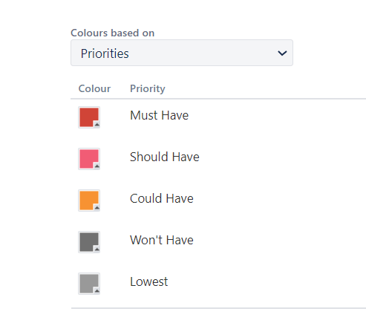
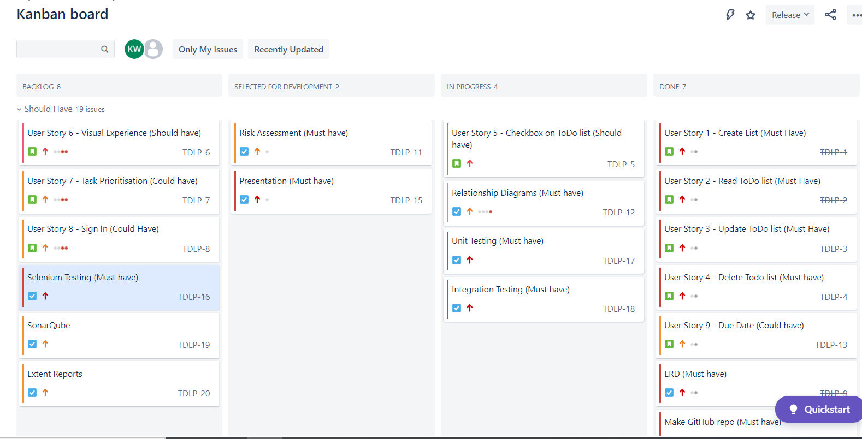
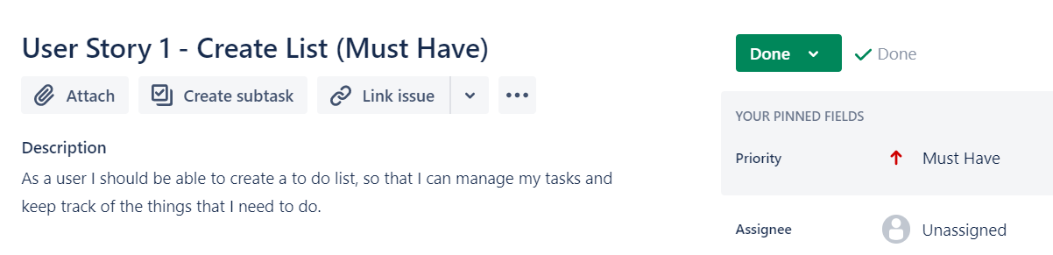
Project Management: Jira
I used MoSCoW methodology to prioritise my tasks
‘As a user, I should be able to create (/read/update/delete) a to do list and items that correspond to that list, so that I can manage my tasks...’

Slide 5
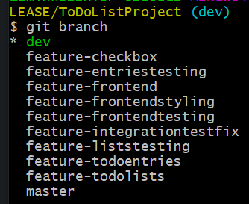

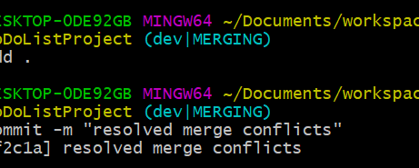
Version Control: GitHub
Utilising the Feature-Branch Model: I integrated code continuously throughout the development process through github, branching off a dev branch into feature branches corresponding to user stories and PBIs
Commits: to track my development progress and ensure the continuous integration of my code through the VCS
I resolved merge conflicts when they arose

Slide 6
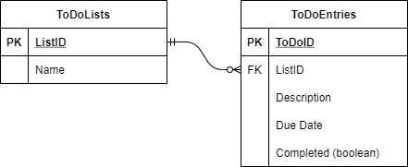
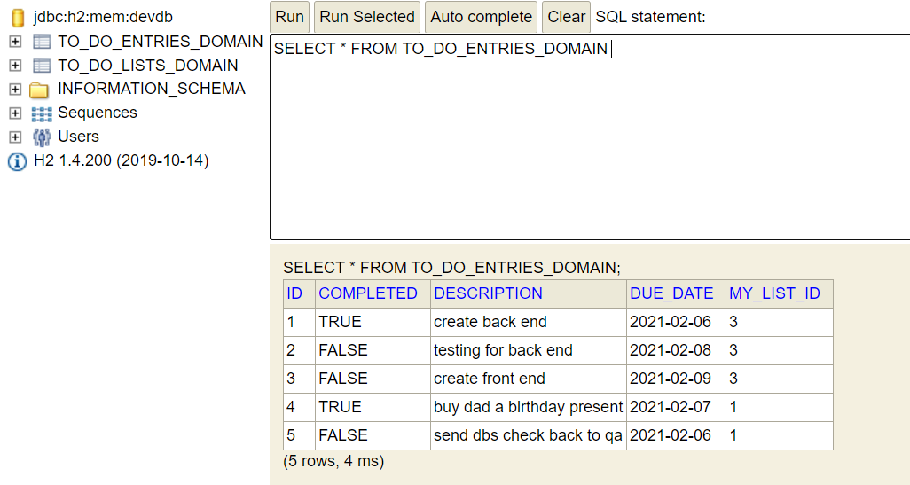
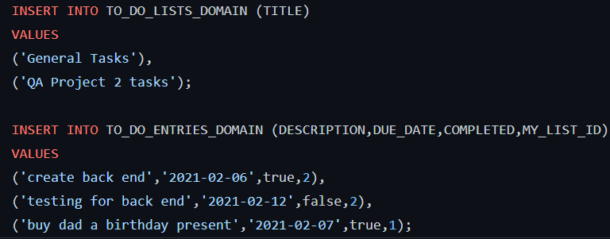
Relational Database - MySQL
ERD:
H2 Console:
DML:
DDL:

Slide 7
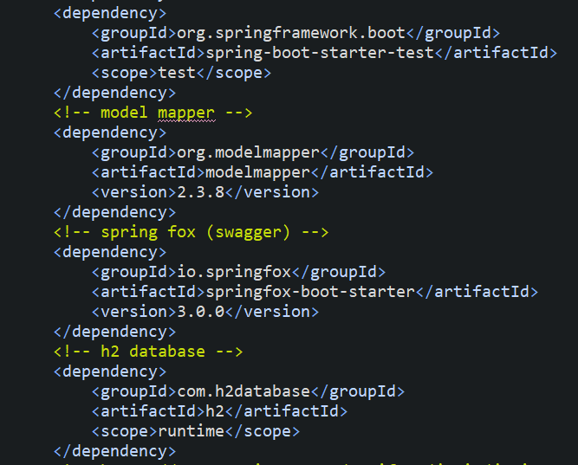
Build Tool: Maven
Example: some dependencies required for the build in pom.xml:
Manages the project’s build; addresses how the software is built and the dependencies it has on other projects
Pom.xml describes the software that is being built, it’s dependencies on other modules, plugins it requires etc
Notes:
‘A build automation tool that…’

Slide 8
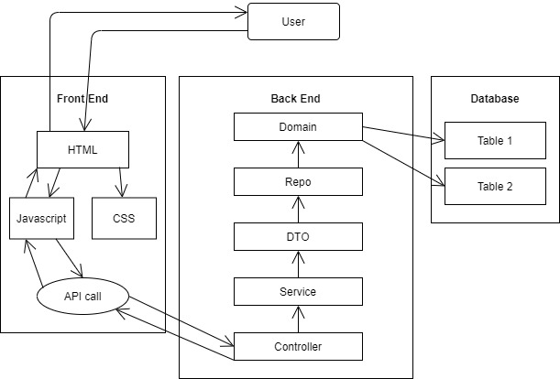
Project Structure
Controller: http requests, has a service
Service: stores logic and calls on repo to extract data to and from the db
Repo: is a DAO, it extends the JPARepository
DTO: prevents certain entities from being directly exposed to users
Domain: POJO - controller receives ID of domain obj...
3 tier architecture
API: allows for the communication and access of data with external software components

Slide 9
User Story focus...
As a user I should be able to create a to do list and add items to the to do list so that I can manage my tasks
Notes:
Seen the database already
I’ll go through back end creation and then some front end creation

Slide 10
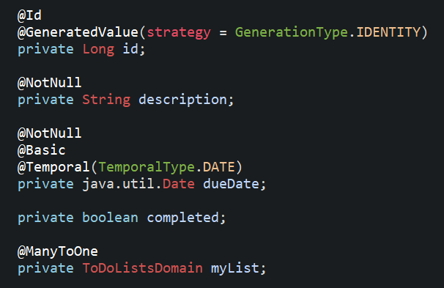
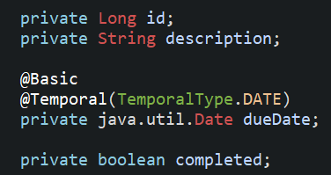
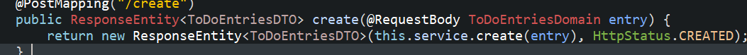
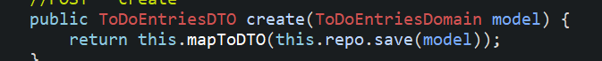
Spring - Building the API at the back end
Domain:
Create method for list entries (to do tasks)
myList is emitted from DTO to avoid a recursive error - list DTO contains a list of objects from the entries domain
DTO:
Controller:
Service:

Slide 11
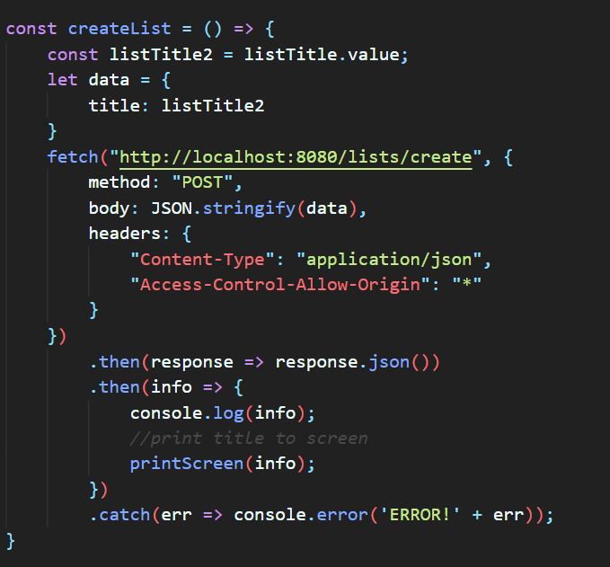
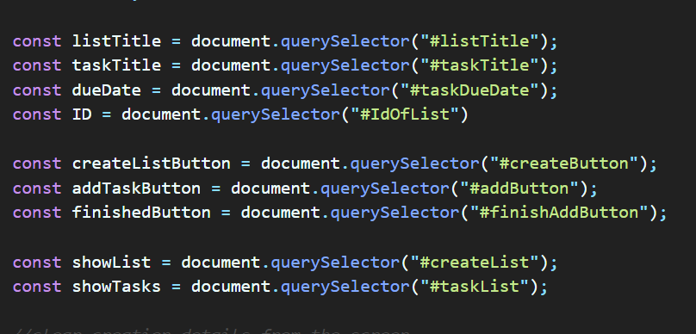
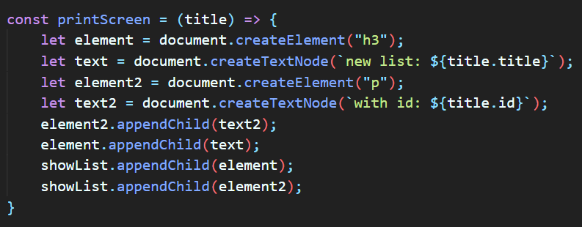
Building the Front End
Javascript
Making an API data request for creating a list:
Using HTML through JS: DOM

Slide 12
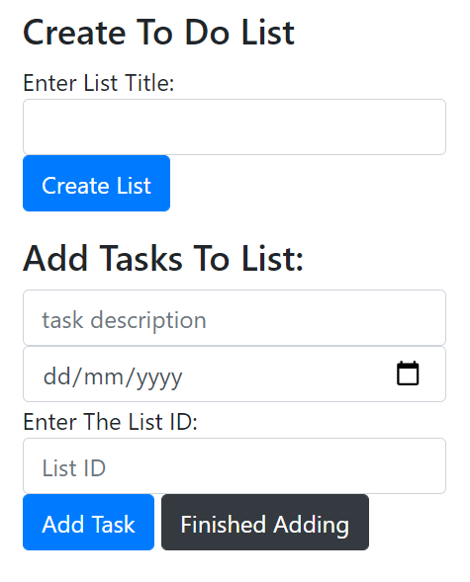
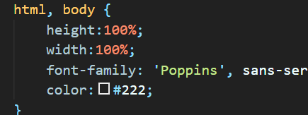
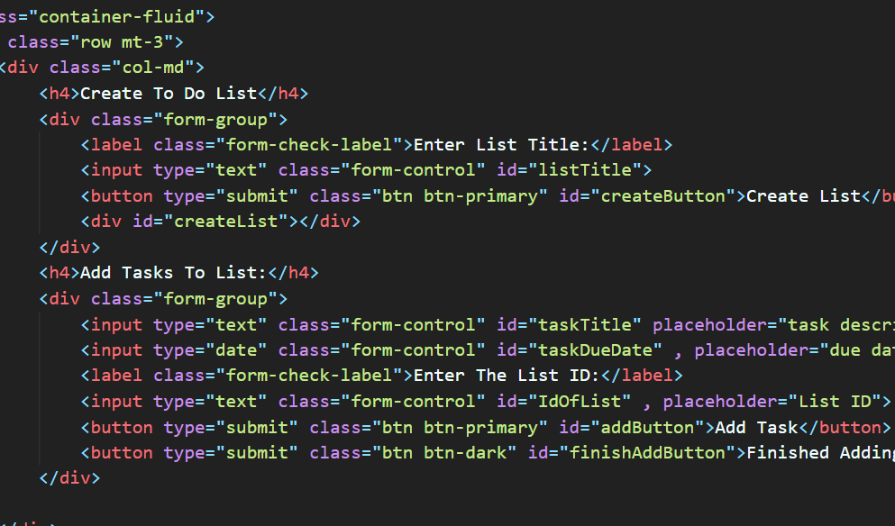
HTML and CSS
Create method as seen on webpage:
The corresponding HTML file for creating a list:
CSS Styling

Slide 13
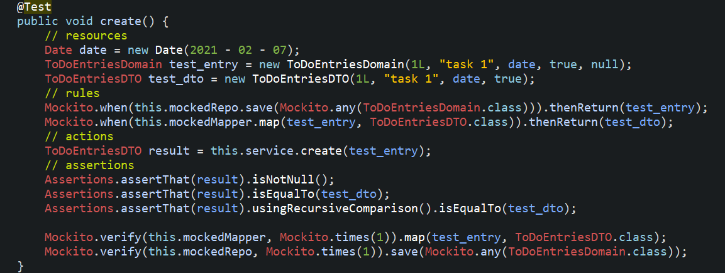
Testing Back End - Unit Tests
Entries Service create test
Mockito allows for creation of test double objects - mock objects. Used to mock interfaces so that a dummy functionality can be added to a mock interface that can be used in unit testing
Unit Tests were used to test this application
Individual units of source code are tested to validate whether code performs as expected
Notes:
Defining the functionality - when the method is called, then return items
Verifying the method has been called # of times we expect

Slide 14
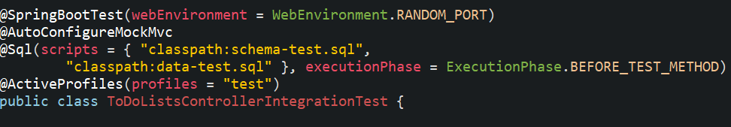
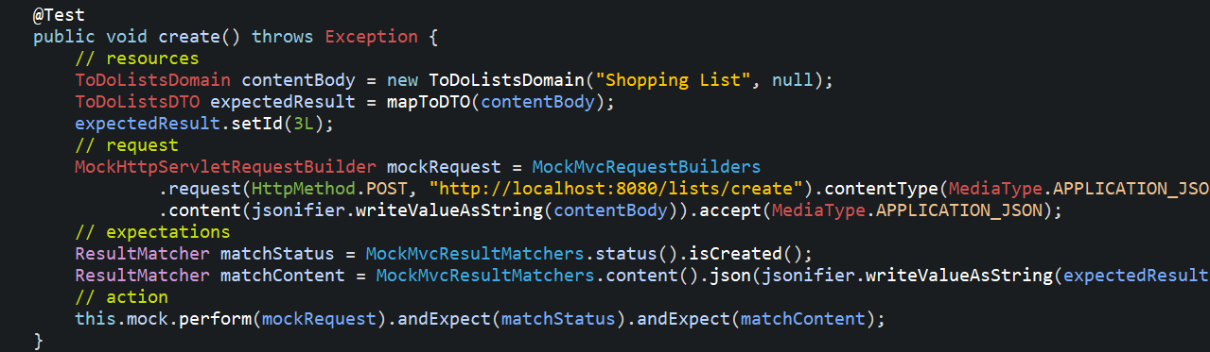
Testing Back End - Integration Tests
Test Setup
Mockito was used in these tests
Create Lists Integration Test
Ensuring that classes who communicate behave in the way we expect, integration system tests test the relationships between classes
Notes:
, the communications go all the way through to the db and back to the controller and prove the CRUD functionality

Slide 15

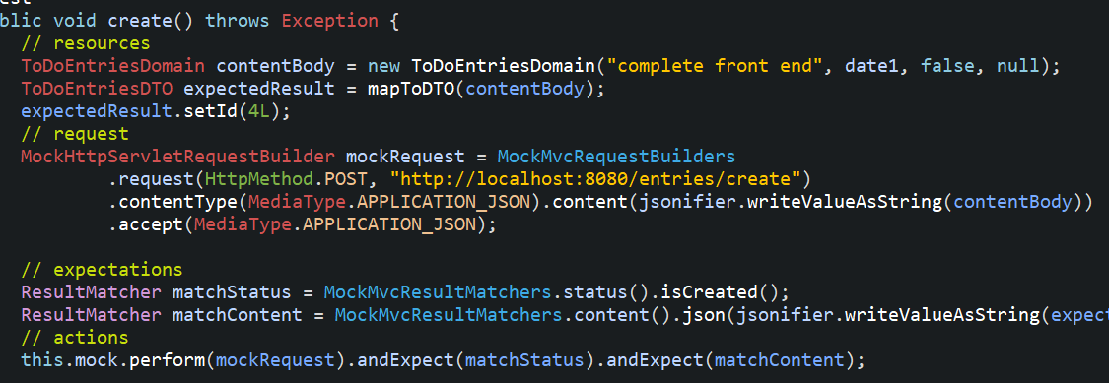

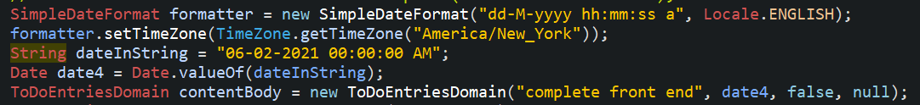
Integration Test problem
The Error:
The Test Method:
In Domain and DTO:
Some Attempted Solutions:

Slide 16
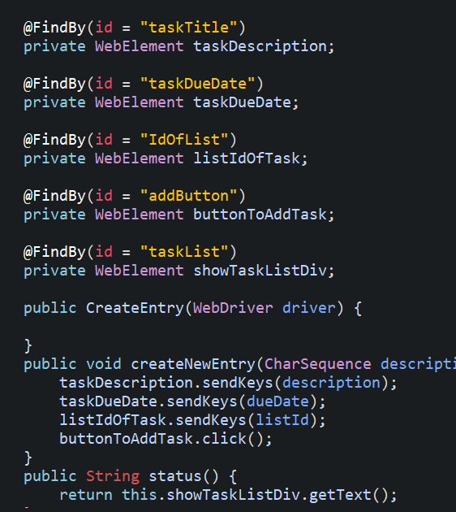
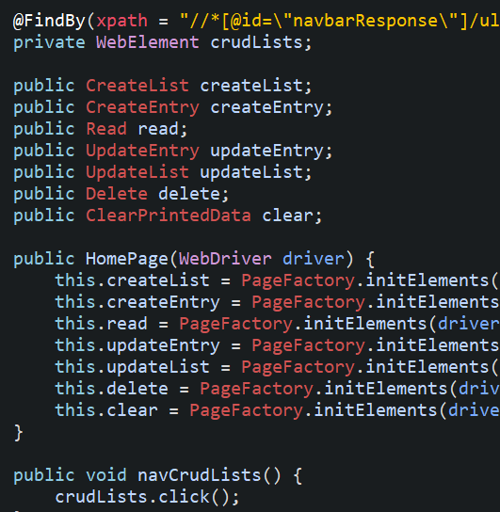
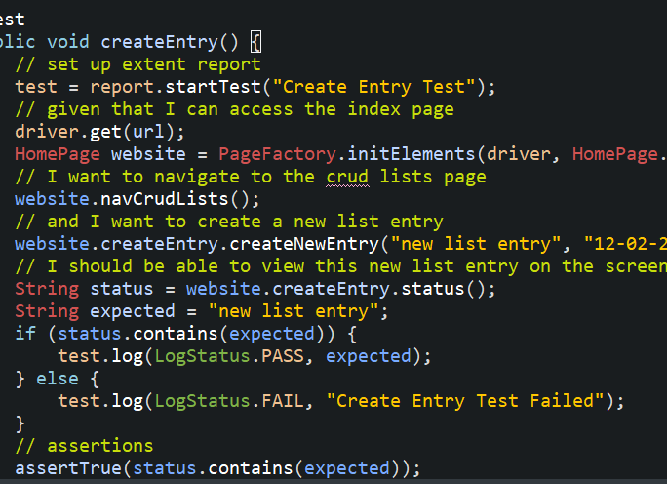
Selenium Testing
Browser-based automation tests, using POM structure - web elements and methods that interact with them in same class
Create Entry class:
Web Page Class:
Create Test in Test Page class:
Notes:
Behaviour driven development
Browser-based automation tests: automating testing across a web browser
Pom structure - web elements and methods that interact with them in the same class
I separated my classes into each CRUD action for clarity and ease of test writing

Slide 17
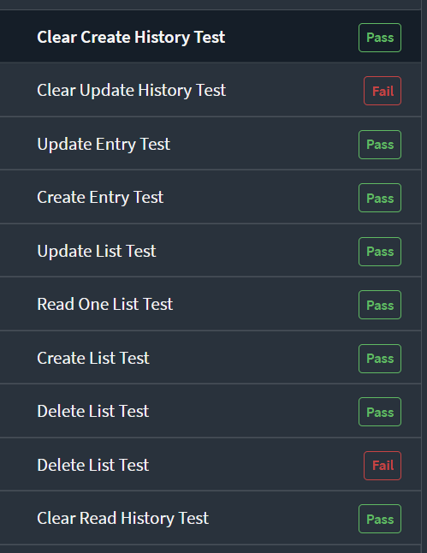
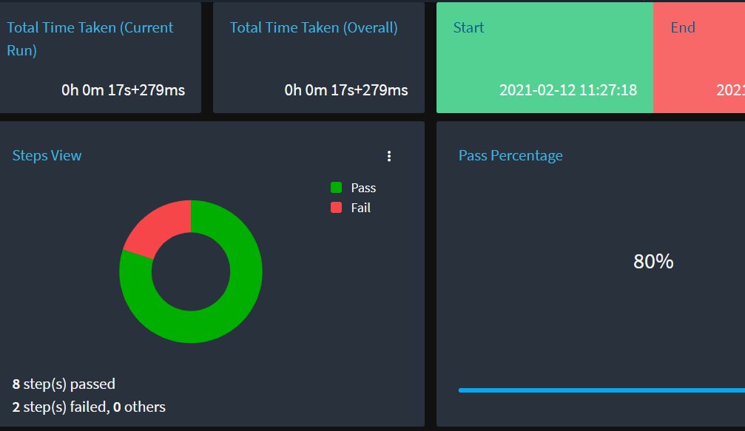
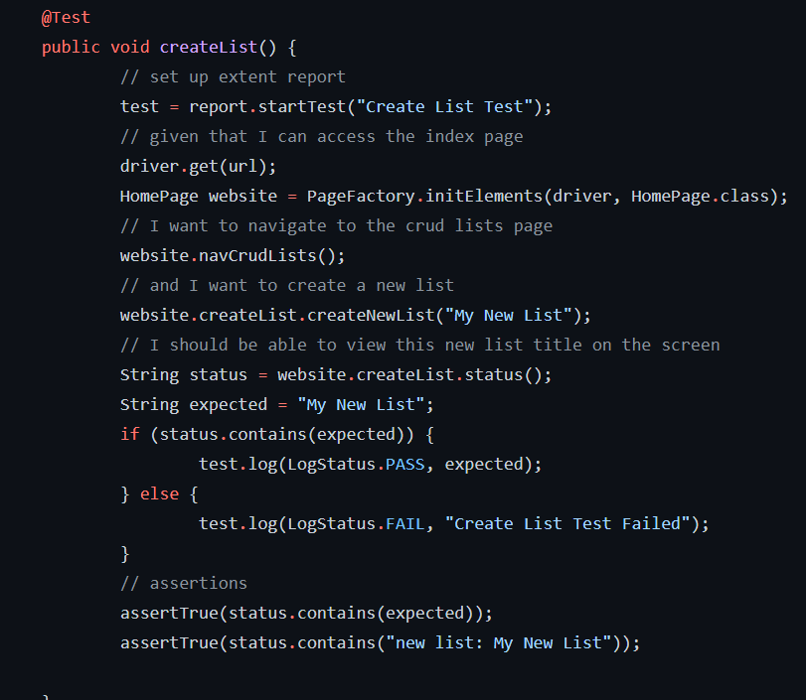

Extent Reports for Selenium Tests
Using extent reports to model results from selenium tests

Slide 18
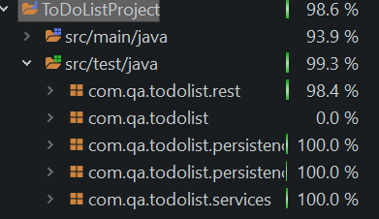
Test Coverage

Slide 19
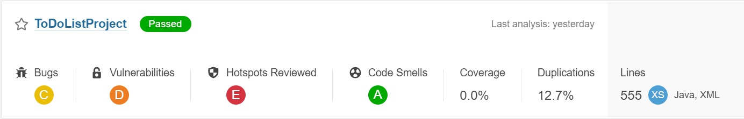
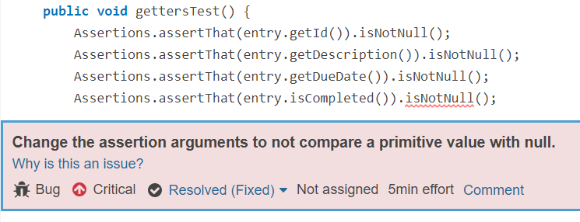
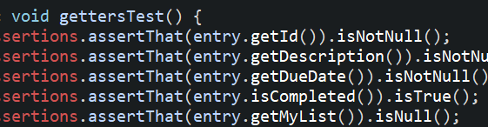
SonarQube - Static Analysis of Code
The initial analysis results:
Critical Bug:
Solution

Slide 20
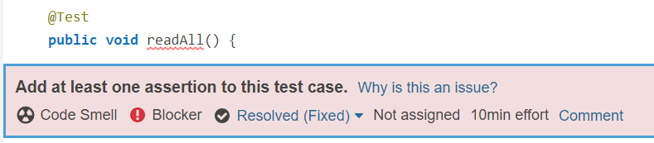
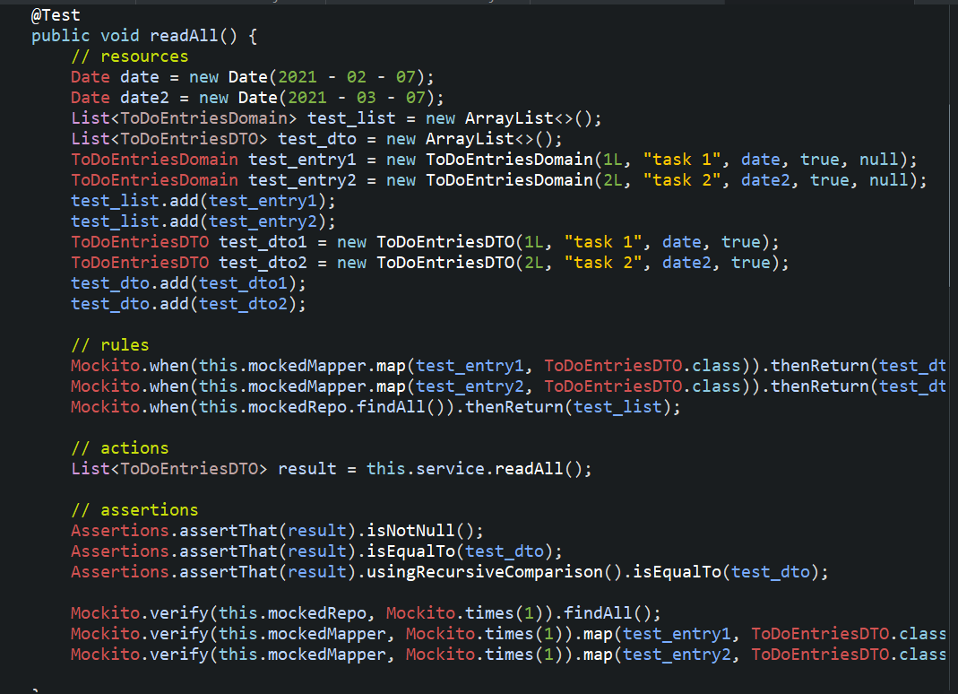
SonarQube - Static Analysis of Code
Code Smell Blocker
Solution
SonarQube brought my attention to a test I had failed to complete
Using behaviour driven development, I wrote out the read all unit test for one of my service classes

Slide 21
Live Demo
I will now present a live demo of the finished application...
http://localhost:8080/index.html

Slide 22
Sprint Review/Retrospective
What went well:
What I could have done to improve:
Time-management
Prioritisation of tasks
Test coverage
Successfully applied newly learned languages and technologies
Had option to delete or edit list/task item when it was printed to screen
Resolved date value problem (api json returns time as well as date)

Slide 23
Any Questions?

